Slide 1
Customer Churn Analysis
Data Dogs: Inseo Baek, Stephanie Law, Jenny Kim

Slide 2

Why do customers leave?
Notes:
Personal experience: from a customer POV, some factors include:
Overcharges/ expensive data plans
Also bad customer service experience
Better plan elsewhere from competitive companies

Slide 3
Data Analysis

Slide 4
Quick Summary of Dataset
3333 customer data in total, with no empty values
Customers spend about 100-120 mins on average during day, evening and night calls
International calls are the most expensive, than day > evening > night in the following order
Average of 1.5 customer service calls

Slide 5
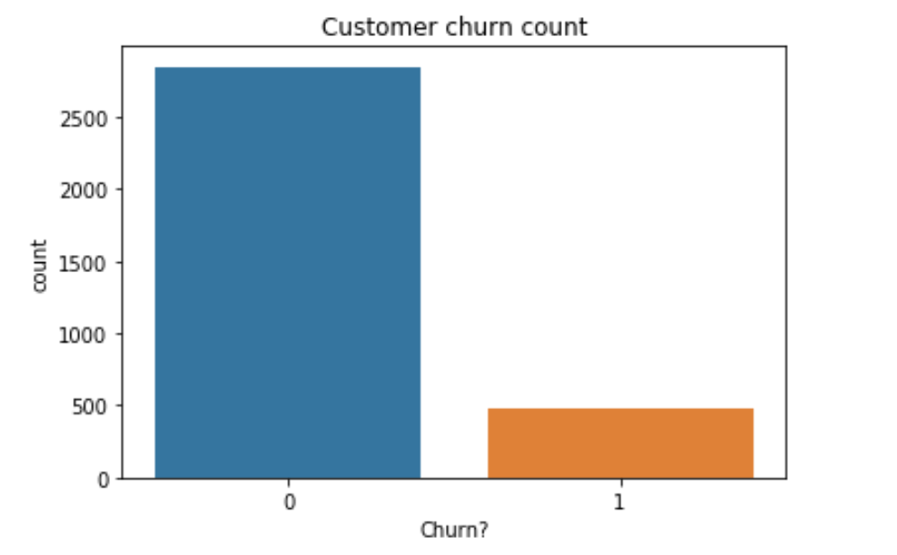
Churned vs Current Customers
Notes:
Current data set is representative of current customers
Very few churned customers; yet we are interested to determine what features affect their decision to leave

Slide 6
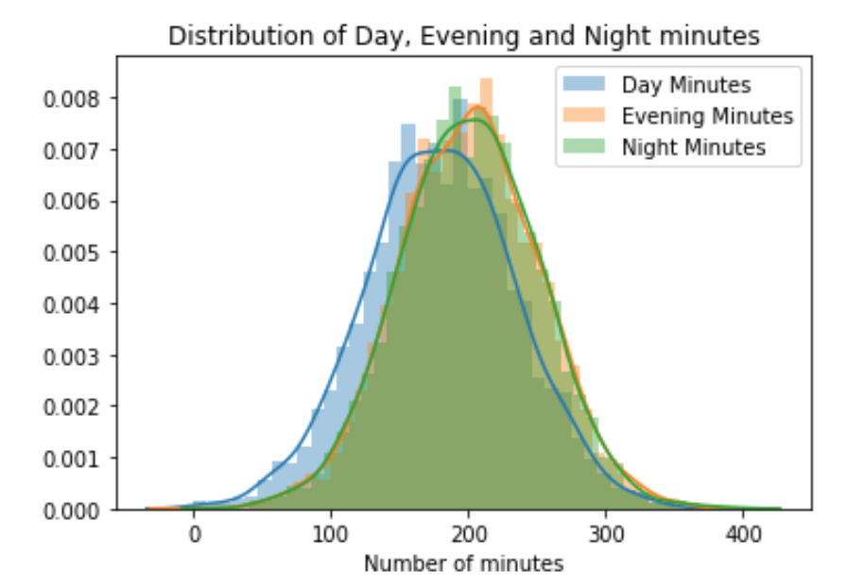
Customer Usage by Minutes
Notes:
Day, evening and night minutes are pretty much all between 100-300

Slide 7
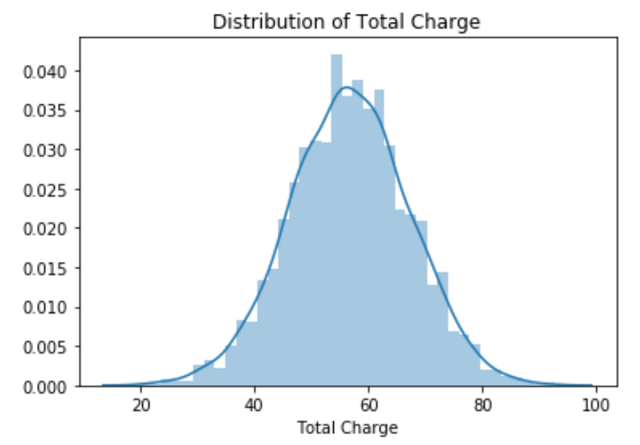
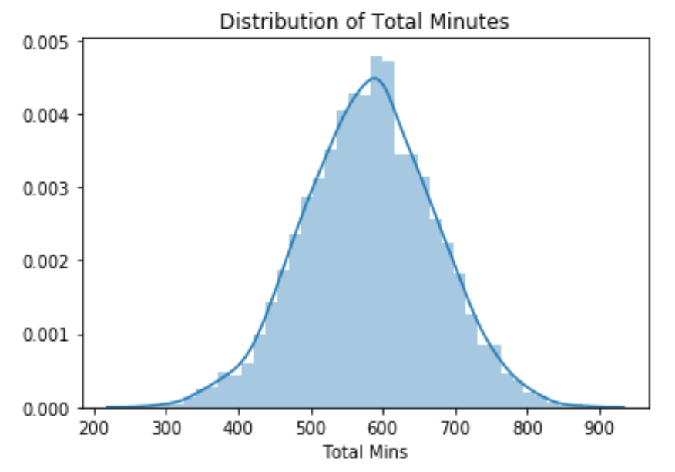
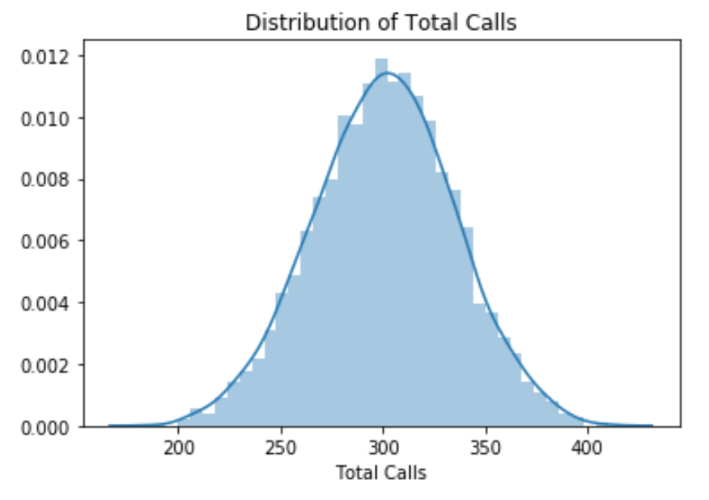
Total Charges, Minutes, and Calls
Notes:
Total Charges: around 60
Total Minutes: around 500-700
Total Calls: Around 300 calls

Slide 8
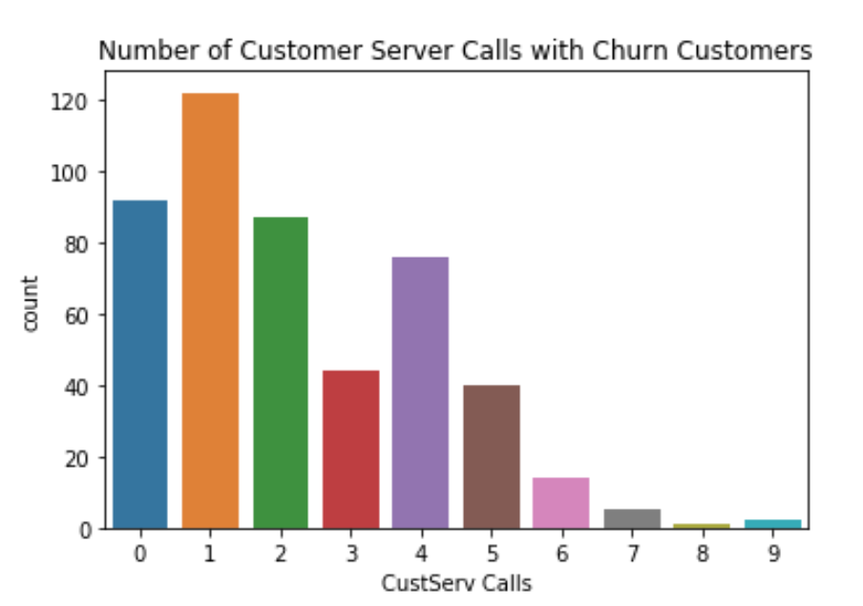

Customer Service Calls Churned vs Current
Notes:
For churned customers, we notice that customer service calls at 4 or 5 times are higher than current customers
Both data sets have a lot of one customer service call
2 customer service call group is similar in both datasets

Slide 9

Int’l Plan Churned vs Current
Notes:
People with international plan churned more, even though both data sets mostly don’t have international plan
Logically speaking, people with international plan are likely to move back to their home country, change plan, etc...

Slide 10
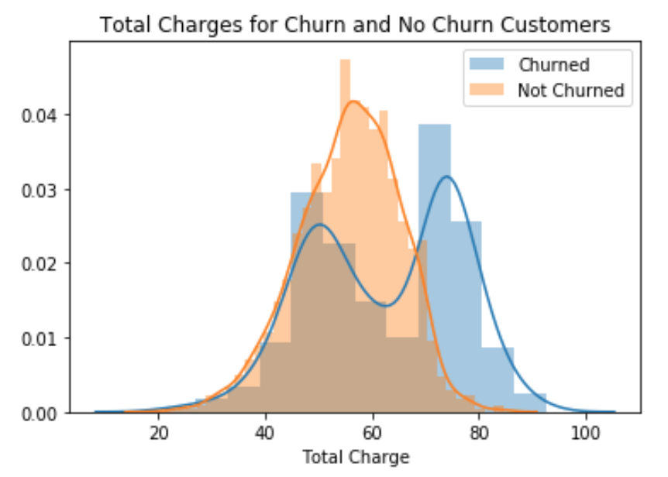
Total Charges Churned vs Current
Notes:
There is noticeable difference in distribution for total charges for churned vs current customers
Churned customers were “charged more”

Slide 11
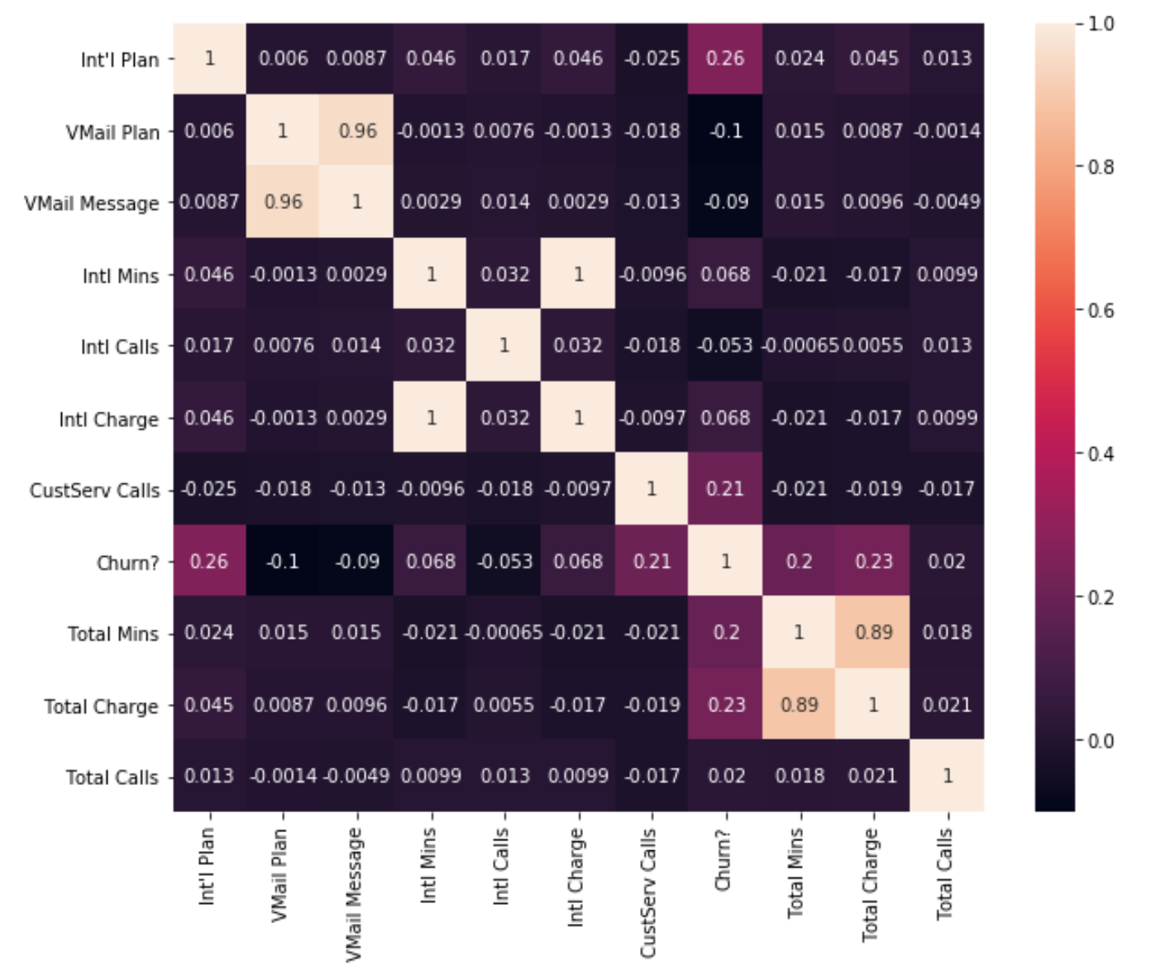
Notes:
Correlation heat map of the relevant features
Don’t want to add all the features so we dropped day, evening, night mins/charges/calls
We see that the highest correlation lies in customer service calls, Int’l plan

Slide 12
Predictive Modelling

Slide 13
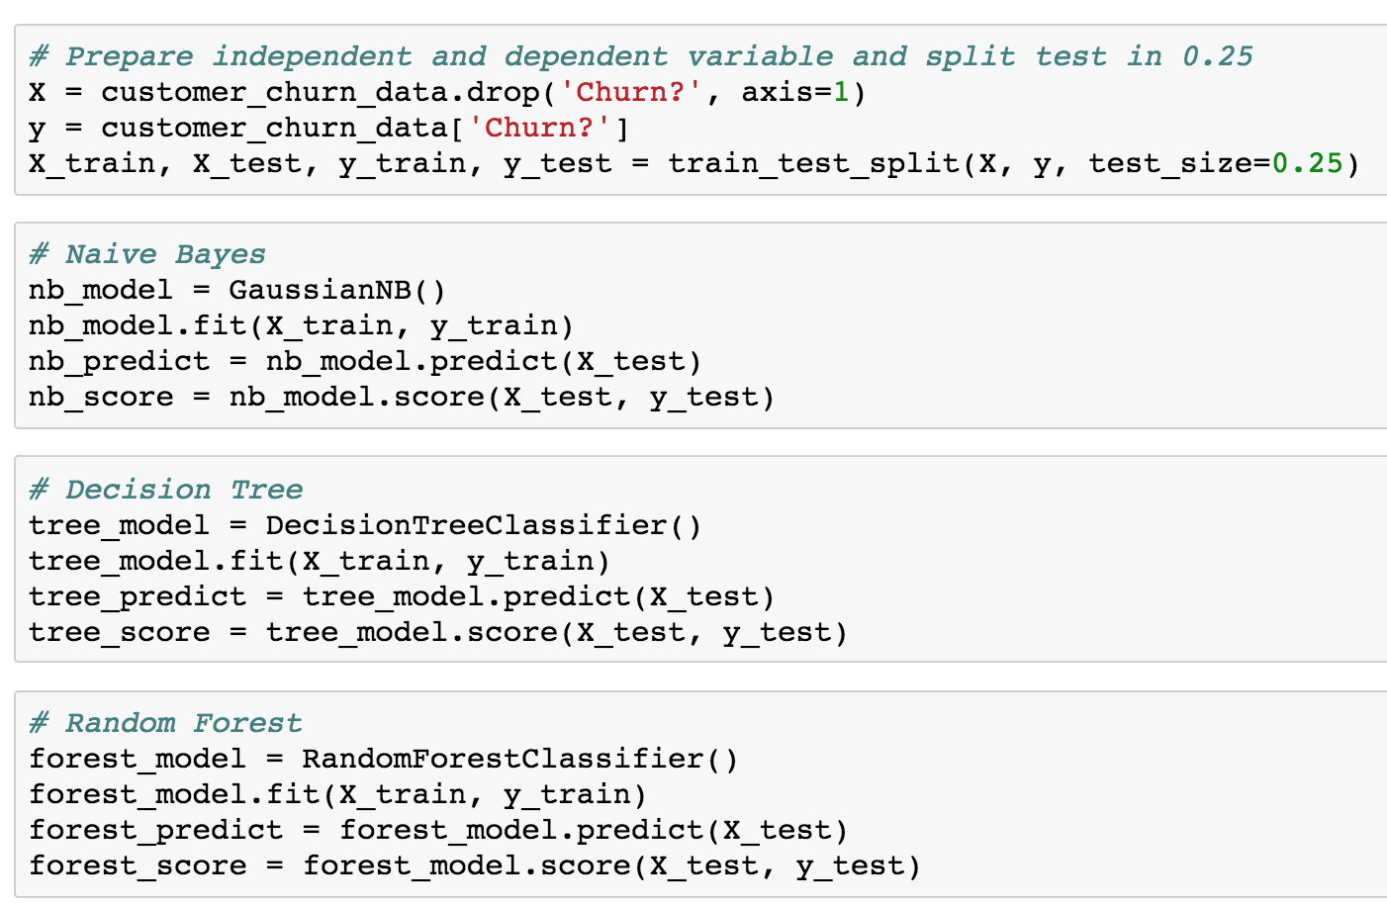

Classification Models Code

Slide 14
Model Evaluation Report
Naive Bayes 88%
Decision Tree 95%
Random Forest 96%

Slide 15
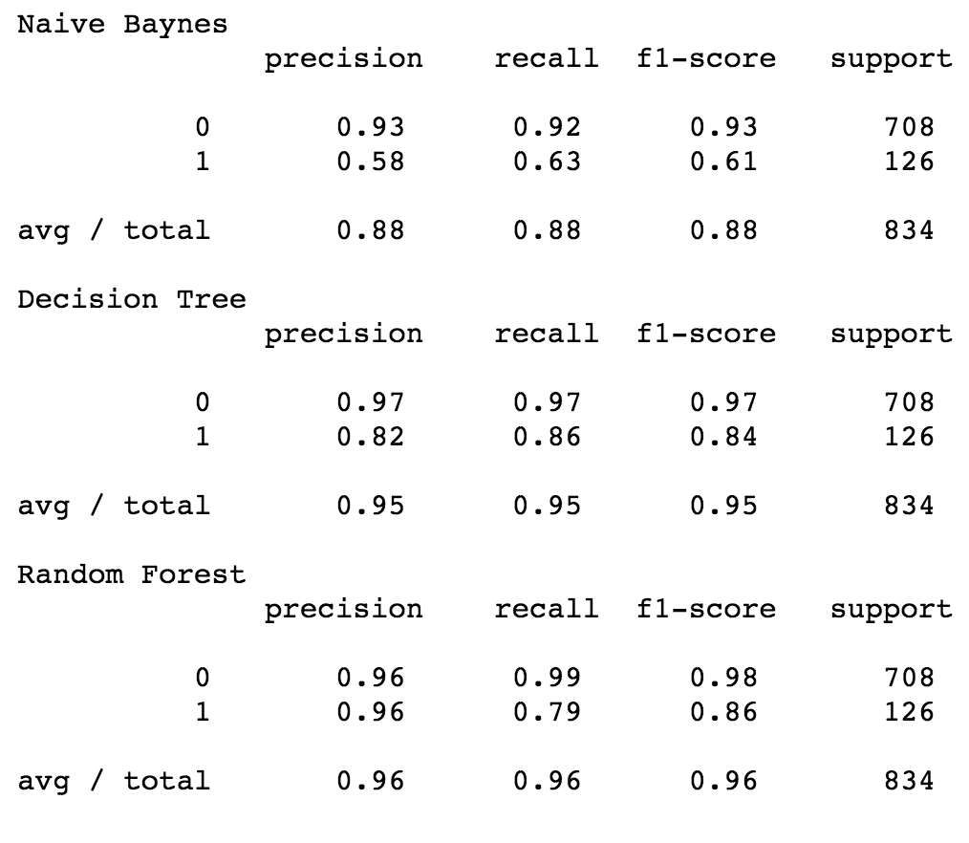
Notes:
More detailed view of classification report

Slide 16
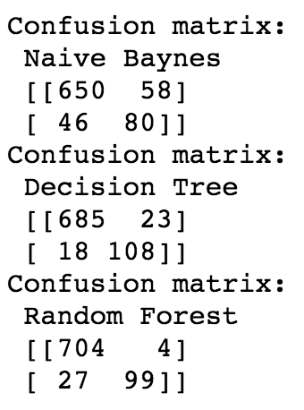
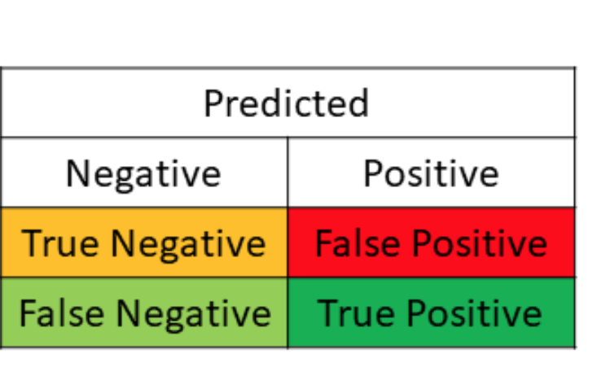

Slide 17
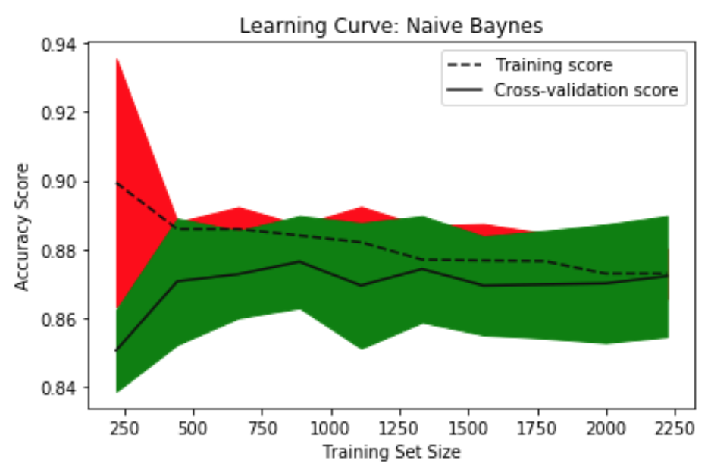
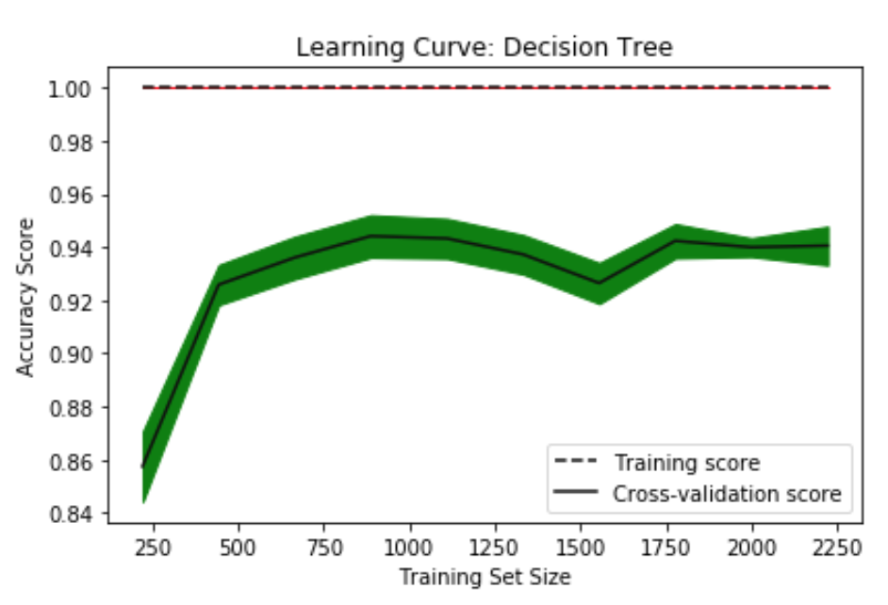
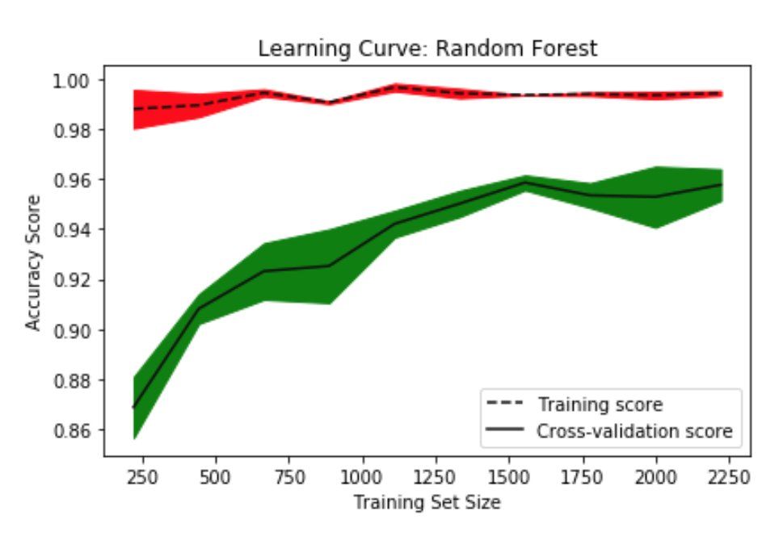
Notes:
Learning curve refers to : “A learning curve shows the validation and training score of an estimator for varying numbers of training samples. It is a tool to find out how much we benefit from adding more training data and whether the estimator suffers more from a variance error or a bias error. If both the validation score and the training score converge to a value that is too low with increasing size of the training set, we will not benefit much from more training data. In the following plot you can see an example: naive Bayes roughly converges to a low score.”
We see that random forest performed best in learning curve

Slide 18
Business Strategy

Slide 19
Business Recommendations
Provide better customer service by expanding CS platforms
Provide phone plan deals and incentives for those who have relatively high charges
Provide more international plan options

